Slide 1


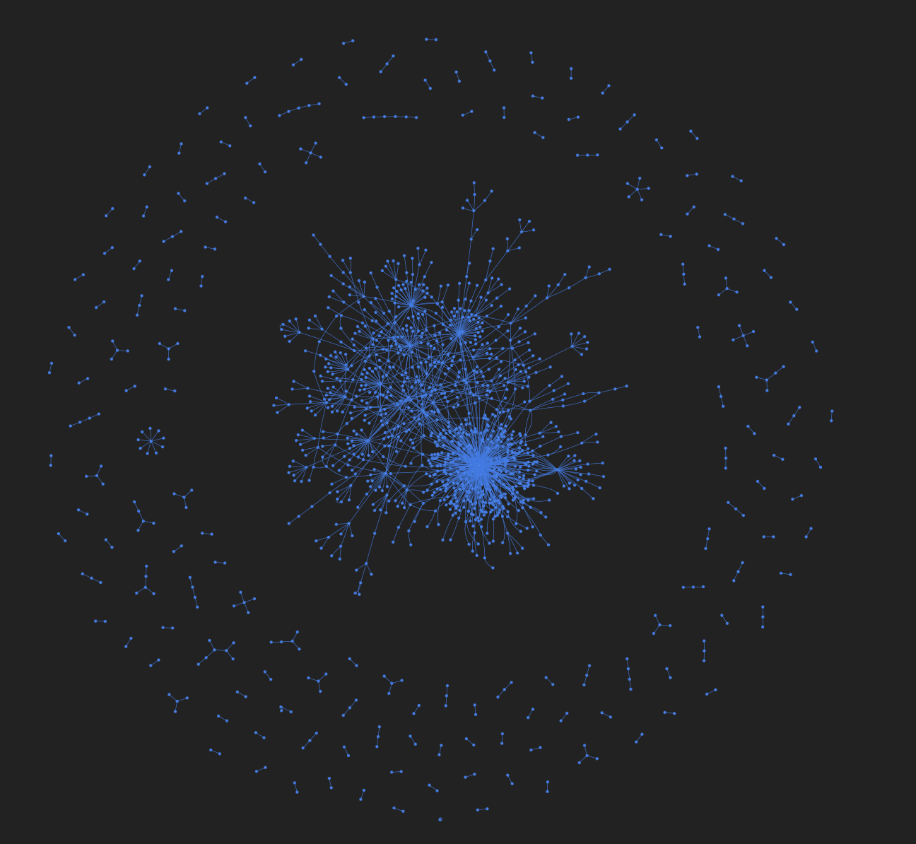
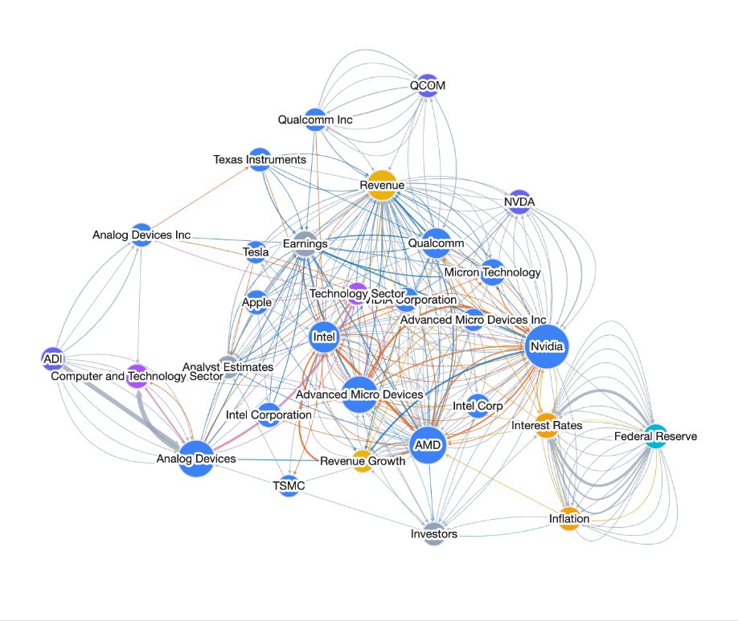
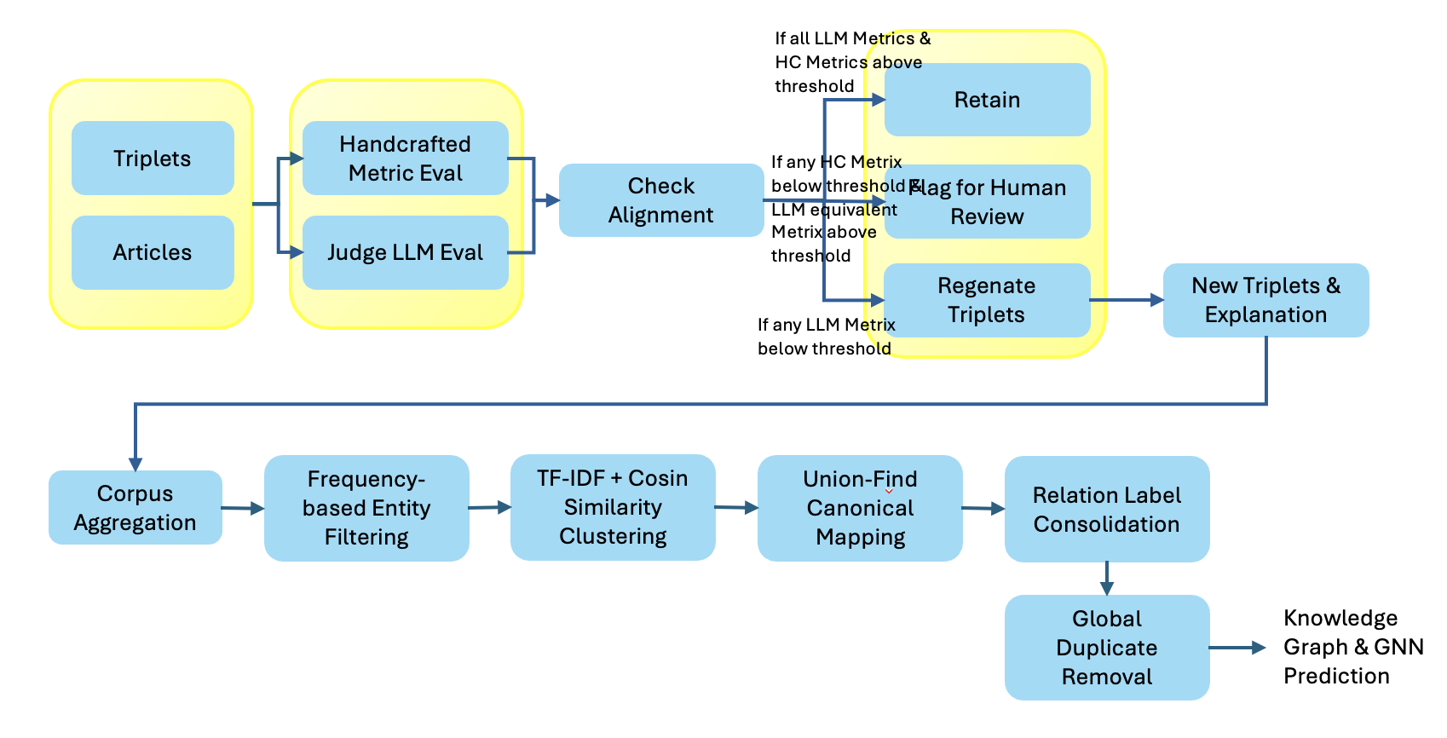
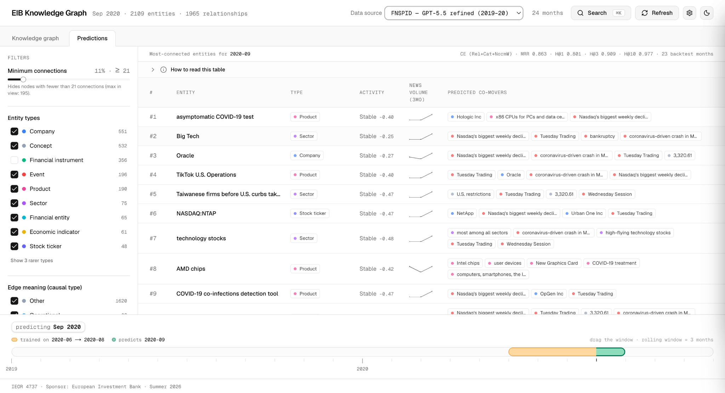
LLM and Graphs for Financial Texts
Alexandra Paiz Delgado, Pierre Pujol, Ruiwen Wang
EIB Advisors: Giuseppe Bonavolontá, Oleg Reichmann
Columbia Faculty Advisors: Dr. Ali Hirsa, Miao Wang
Introduction
Deployment
Financial markets are driven by large volumes of unstructured news containing complex and evolving relationships. Over four semesters this project built the machinery to extract that structure: LLM triplet generation, Judge LLMs with targeted regeneration, corpus canonicalization, and GNN link prediction. What remained was the gap between a pipeline the team runs and a system a sponsor uses.
This semester closes that gap. We processed the entire 15-year FNSPID corpus (54,563 articles, 2009 to 2024) through the full three-LLM chain on a single GPU, then put the same machinery into daily production on two live corpora, STOXX Europe 600 and the full S&P 100, refreshing the knowledge graph, a five-factor news model, and continuously retrained GAT predictions every morning with no human in the loop. Everything ships as a public web application with draggable timelines, per-corpus tabs for graph, predictions, and factor archetypes, a Claude/MCP connector for plain-language analysis, and a documented handover. It is ready to use.
The system ships as a finished product: https://eib-knowledge-graph.vercel.app.
The frontend is Next.js + TypeScript with Tailwind/shadcn styling and a custom d3-force graph engine, chosen so the entire app compiles to a static site. All data is plain JSON on a CDN, so there is no server, no database, and nothing to maintain or pay for. A daily cron on the team VM does the only moving work: scrape, three-LLM chain, canonicalize, retrain. Git push redeploys the site automatically; a pulsing Live badge shows the last real pipeline run.
One dropdown switches between news corpora (15-year Cull Corpus FNSPID (Qwen 2.5), 2019-2021 FNSPID (GPT 5.5), live STOXX 600, live S&P 100). Per corpus, separate tabs show the knowledge graph, the GAT predictions, and the factor-model archetypes for the two live data sources, all navigated by draggable timelines. Analysts can also connect Claude to the corpus through a built-in MCP endpoint (public URL, no key) and interrogate the news behind any node in plain language.
Inheritance is designed in: a two-tier handover runbook (maintain vs. full rerun) is linked from the app's own settings; production needs no API keys anywhere, and every account binding (repo, hosting, VM) is swappable. Unmaintained, the site degrades gracefully into a permanent static archive; maintained, it costs one cron on one GPU. It is ready for the sponsor to use today.
Figure 2: GAT Results
Figure 3: GAT UI
Figure 1: Unified End-to-End Pipeline
Multi-LLM Benchmark & Model Selection
GAT Link Prediction
The team evaluated the performance of 7 LLM models on the triplet extraction part using 4 metrics: uniqueness, coverage, semantic validity and consistency:
Predictions come from a Graph Attention Network (GAT), a graph neural network performing temporal link prediction in the style of FinDKG: trained on a rolling three month window, it forecasts which links appear next, served as monthly leaderboards with novelty z-scores and predicted co-movers.
The key experiment held the model fixed and changed only data quality: 0.766 on unrefined triplets, 0.863 after GPT-5.5 judging, refinement, and gating. Same model, same articles, +0.10 MRR from the quality chain alone. The finalized 15-year corpus serves predictions over 80+ backtest months, and the live corpora retrain daily (STOXX at 0.910, provisional on a young backtest).
 | Claude Sonnet 5 | GPT 5.5 | Gemini | Qwen 2.5b | Mistral | LLama 3.1 | Kimi K3
Coverage | 0.68 | 0.72 | 0.74 | 0.69 | 0.69 | 0.66 | 0.67
Uniqueness | 0.89 | 0.88 | 0.83 | 0.92 | 0.89 | 0.88 | 0.87
Semantic Validity | 0.83 | 0.85 | 0.84 | 0.81 | 0.80 | 0.73 | 0.85
Consistency | 0.94 | 0.95 | 0.92 | 0.95 | 0.91 | 0.90 | 0.94
Table 1: LLM Benchmark Comparison
Figure 4: Predictions UI
No model dominates across all four metrics: GPT-5.5 leads on semantic validity (0.85) and ties for best consistency (0.95), while Qwen 2.5b posts the highest uniqueness (0.92) and ties on consistency. The other five models cluster in the middle without topping any metric, making them less differentiated for the pipeline. GPT-5.5 and Qwen 2.5b each maximize a different axis of extraction quality (reliability/validity vs. distinctness), which is why we chose to keep them for their respective advantages. We ran two versions of the FNSPID corpa: one with GPT 5.5 extraction (with API costs) from 2019-2020, and a full corpus run with 0 API costs with Qwen 2.5b.
Live Corpora & the News Factor Model
Final Thoughts
Everything upstream ran on a static research dataset (FNSPID's news ends 9 Jan 2024). We therefore stood up two fully live corpora, STOXX Europe 600 (sponsor-relevant, six sectors) and the full S&P 100 (~101 constituents), and these are not a side demo: they exercise the entire deployed pipeline, end to end, every day. A 07:30 UTC cron on the team VM fetches per-ticker news, extracts with an enriched schema (each triplet carries sentiment, dollar materiality, and an event type), passes the same Judge-and-refinement chain and three-pass canonicalization as the historical corpus, and merges the result into monthly knowledge-graph snapshots — so the interactive graph, entity filters, and industry views in the UI grow with the news, with no human in the loop and zero API spend (using Qwen 2.5b via Ollama). Once a corpus accumulates enough months, the cron's GAT stage activates automatically: the CE No-Edge-Feats configuration retrains overall accumulated months and republishes the predictions leaderboard each morning. STOXX already predicts live and the S&P tab flips on the first morning its history supports a training window.
On top of the enriched triplets sits the Fama–French-inspired news factor model in a separate tab: every entity scored daily on Attention, Sentiment, Consensus, Novelty, and Materiality (based on Summer 2025's Judge-LLM design); z-scored factors feed KMeans clustering in the full factor space, discovering news archetypes with no sector labels supplied (e.g., Novo Nordisk / Shell / Volkswagen emerge as the heavily-covered-but-contested cluster), with PCA projecting to two axes for display only. The live corpora are thus the proof of the semester's thesis in miniature: the same extraction, quality control, graph construction, and prediction machinery validated on fifteen years of history, running itself in production on today's news.
The semester closes with the loop fully shut. The entire 15-year FNSPID corpus is finalized: every article extracted, judged, and refined by the three-LLM chain, canonicalized at corpus level, and served with rolling-window GAT predictions over more than a decade of backtest months. This accomplished at $0 in API cost (Qwen 2.5b), on a single GPU. The same machinery now runs itself daily on two live corpora, growing the knowledge graph, the factor archetypes, and the predictions every morning with no human in the loop. The through-line is that quality control scales down in cost: the discipline prior semesters proved drives predictive performance (judge, refine, canonicalize, strict graphs) no longer requires a budget, only a benchmark-validated local model. What began five semesters ago as a triplet-extraction experiment is now a deployed, self-sustaining, sponsor-ready system: public, documented, keyless in production, and built to be inherited.
Full-Corpus Production Run
The runs are an integration of every prior team's work: extraction uses the Fall 2025 unified pipeline's generator and prompt (6-tuple schema with relation categories, Summer 2025's taxonomy), quality control is Summer 2025's Judge-LLM design (coverage, uniqueness, semantic validity, consistency) with its flagged-triplet regeneration, graph construction applies Spring 2025's canonicalization principles hardened with our guards, and training uses the team GAT with the Spring 2026 rolling-window leakage fix.
The final mile our team accomplished is the VM-to-UI publishing pipeline: each finished chunk's judged CSV is converted into the site's static data contract — monthly graph snapshots with precomputed layouts, per-article provenance records, and prediction JSONs — committed by the VM, and every push triggers an automatic Vercel redeploy. The public graph therefore grew live during the run, from 60 to 100+ browsable months as chunks completed, and the same mechanism serves the daily live corpora: from GPU inference to a URL an analyst can open, with no manual step anywhere in between.
References
[1] Li, X. (2023). FinDKG: Dynamic Knowledge Graph with Large Language Models for Global Finance. SSRN 4608445.
[2] Dong, Z. et al. (2024). FNSPID: A Comprehensive Financial News Dataset in Time Series. arXiv:2402.06698.
[3] Lee, G., Gao, J., Lu, X., Cuadros, A. (2025, Dec). LLM and Graphs for Financial Texts.
[4] Chen, X., Chen, X., Yang, Y. (2026, May). LLM and Graphs for Financial Texts.

